Slide 1


Focus Guard
Anti-Procrastination Desktop Assistant JavaFX-Based Productivity and Distraction Monitoring System
Course: Object-Oriented Programming
Saim Ali (Team lead / Project Manager)
Musab Zubair (UI / UX designer)
Saad Iftikhar (Backend Developer)
Educational Desktop Application Project

Slide 2
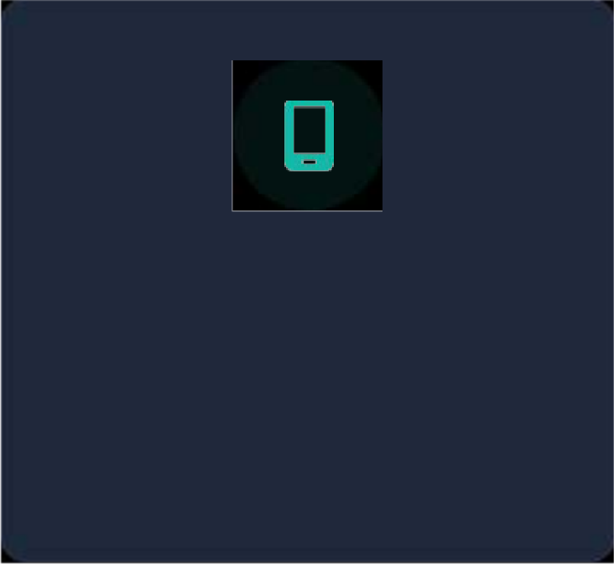
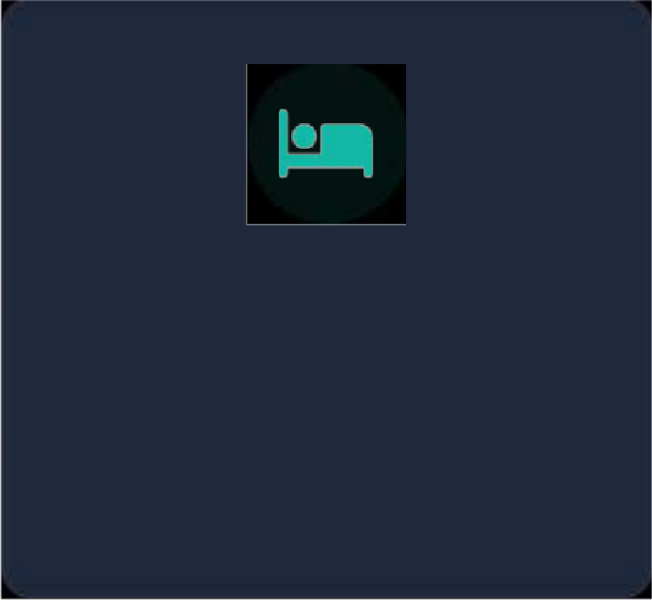
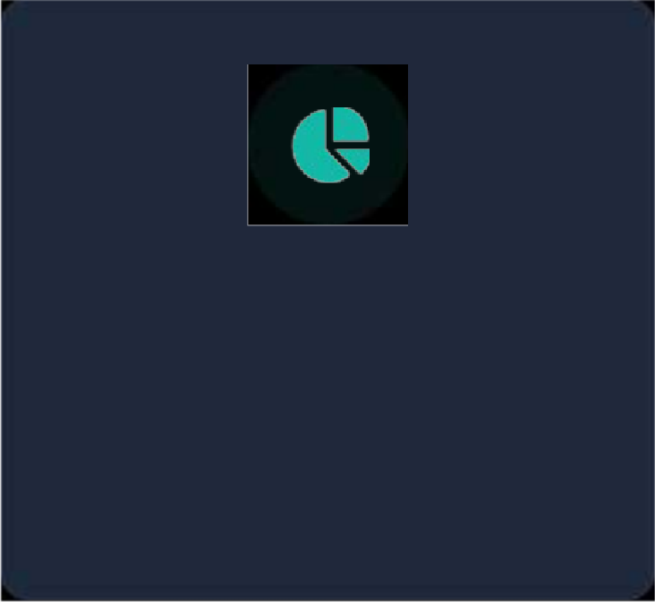
Problem and Motivation
Students often lose focus during study sessions. While simple timers count time, they fail to measure actual
focus quality. Students need a comprehensive tool to track sessions, distractions, tasks, and progress.
Distractions
Browsers, social media, and entertainment apps silently consume valuable study time and break concentration.
Inactivity
Leaving the desk or spacing out goes unnoticed by traditional timers, leading to inaccurate productivity tracking.
Poor Tracking
Lack of historical data and analytics prevents students from identifying weak points and improving study habits.

Slide 3







Proposed Solution
FocusGuard is a desktop productivity assistant that helps students run goal-based focus sessions, monitor
inactivity, detect distracting apps safely, and review their study performance.
1. Study Goal
Define task objectives and duration.
2. Focus Timer
Initiate distraction-free session.
3. Monitoring
Track inactivity & distracting apps.
4. Session Score
Calculate overall focus efficiency.
5. Analytics
Save locally & review study history.

Slide 4
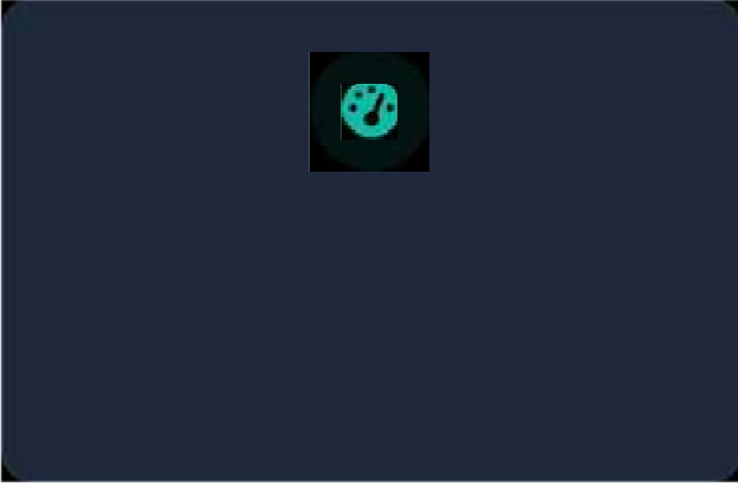
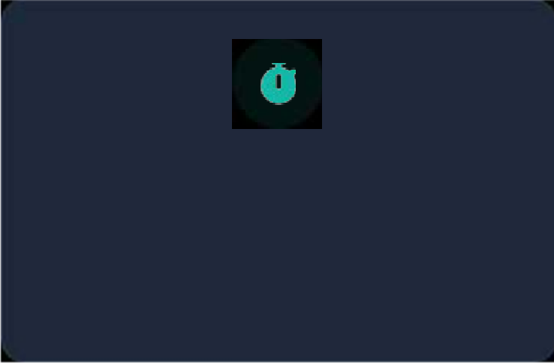
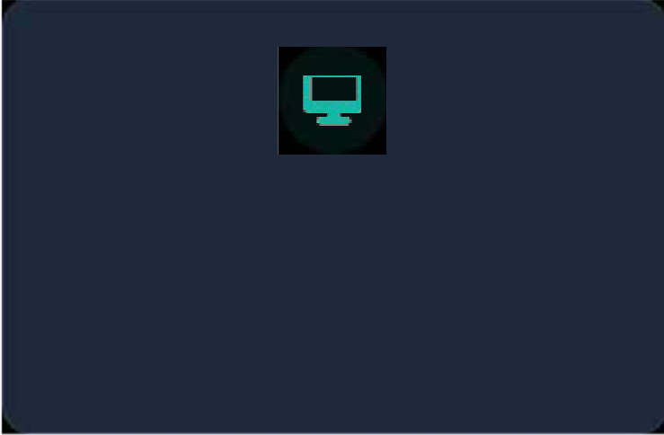
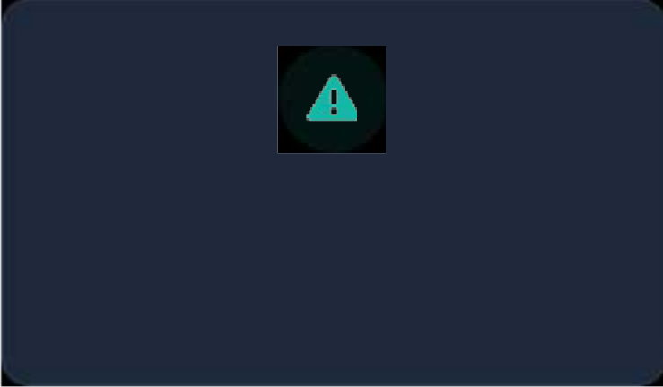
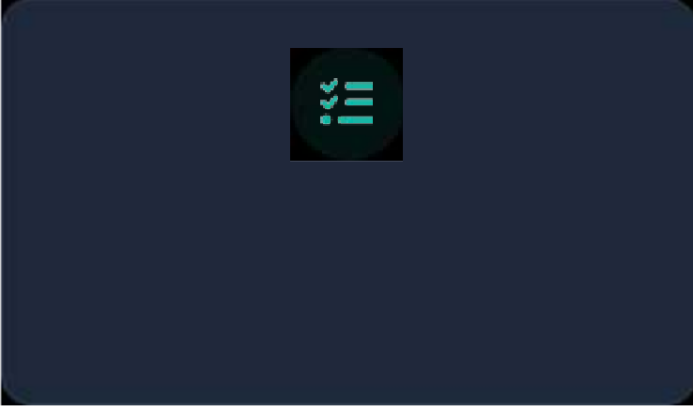
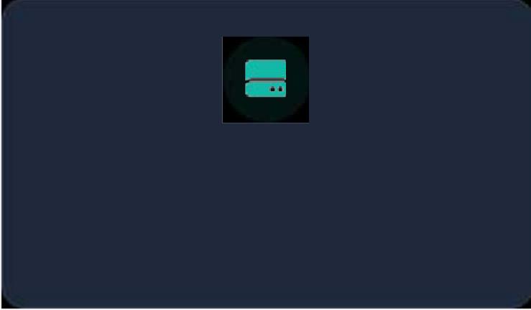
Main Features
Dashboard & Analytics
View real-time productivity metrics and analyze trends using JavaFX BarChart and PieChart.
Focus Timer
Start, pause, resume, and end study sessions utilizing precision JavaFX Timeline.
Inactivity Monitoring
Detect prolonged idle periods through mouse movement tracking.
Distraction Warnings
Detect distracting processes via keywords with a safe strict-mode warning overlay.
Task Planner & History
Plan goals and review past sessions in a clean JavaFX TableView.
Local Storage
Maintain privacy with CSV and properties file handling for all data and settings.

Slide 5
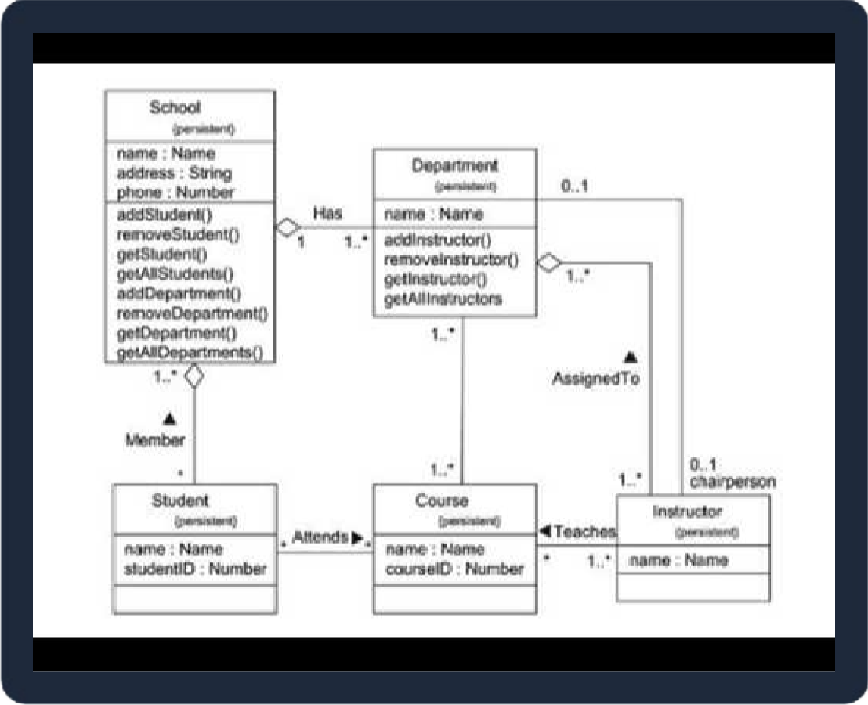
System Architecture & OOP Concepts
Architecture Components
MainApp: Controls navigation and flow. Views: JavaFX programmatic UI screens. Services: Handles logic, monitoring, & scoring. Models: Stores sessions, tasks, and settings. UiFactory: Provides reusable UI components.
OOP Implementation
Inheritance: Custom views extend JavaFX nodes. Encapsulation: Private fields with getters/setters. Composition: StudySession contains tracking events. Aggregation: ProductivityStats uses session data.

Slide 6
Conclusion & Future Scope
Conclusion
FocusGuard is a practical JavaFX desktop assistant tailored for educational purposes.
It successfully integrates GUI development, Object-Oriented Programming, file handling, and system monitoring. By combining timers with productivity scoring and analytics, it provides a complete environment to support focused study sessions.
Future Enhancements
Multi-user profile support Database integration (e.g., SQLite)
Advanced application tracking algorithms Automated break reminder notifications Automated weekly/monthly PDF reports Richer analytics and data export formats

